Slide 1

Power Frequency Control
Process Systems Operations and Economics
By
Talha Tallat Vanesa Sorecau

Slide 2
Introduction
Model Development of the power frequency control
Simulation using Simulink
Time Error in Modern Power systems

Slide 3
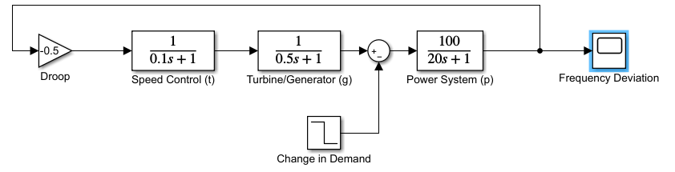
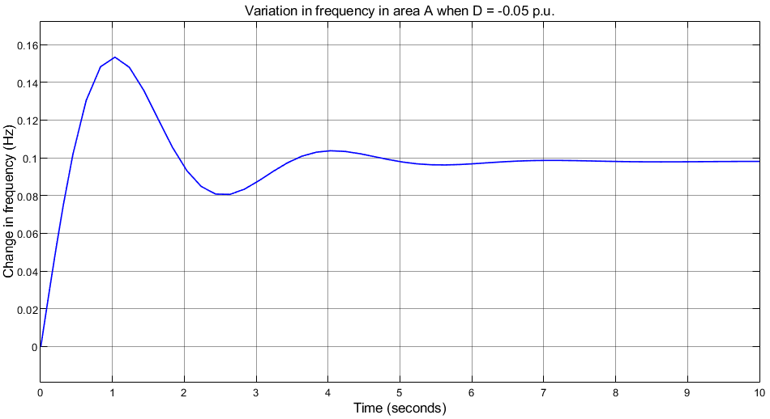
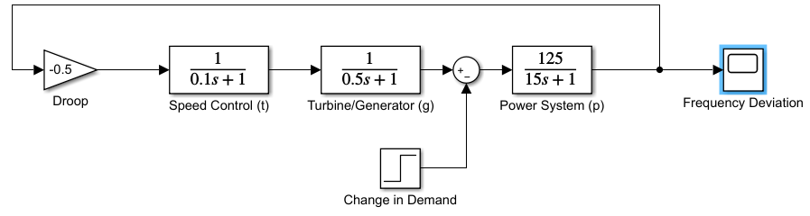
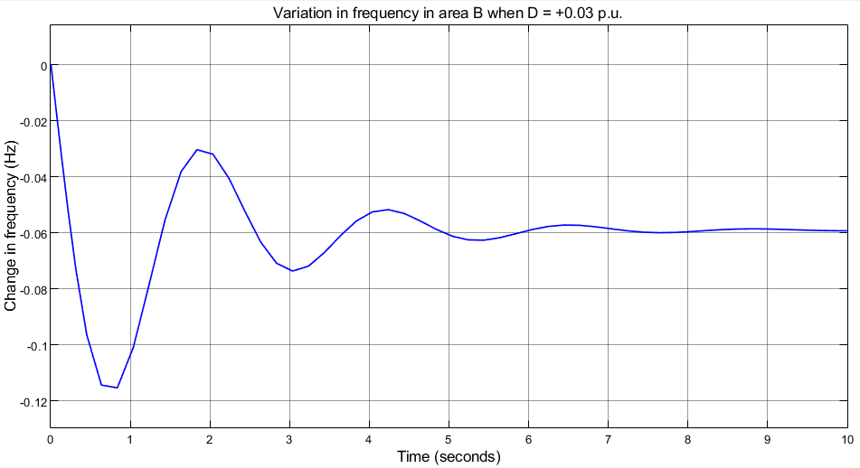
Single control area A & B with load disturbance

Slide 4
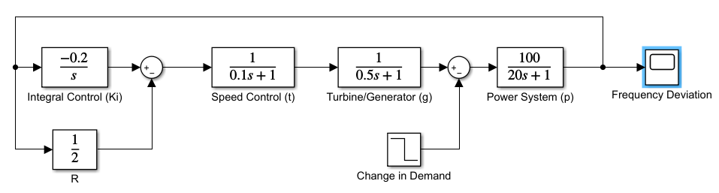
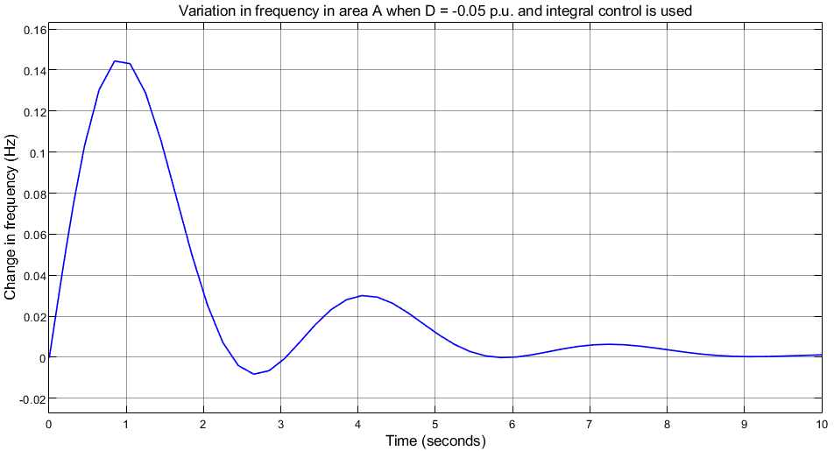
Integral Control
The frequency stabilizes at 0Hz
The frequency decreases at a faster rate
Overtime after applying Integral Control

Slide 5
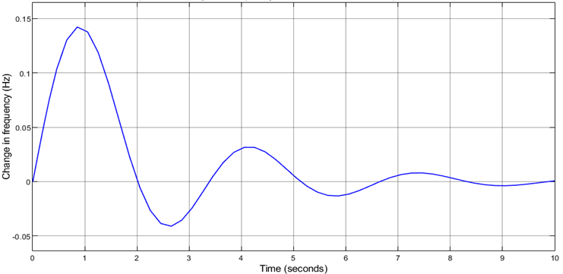
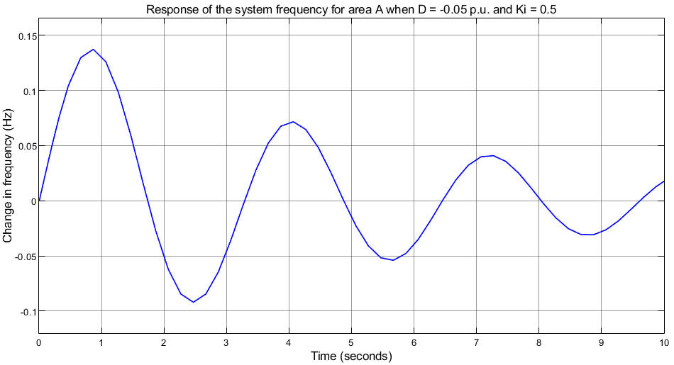
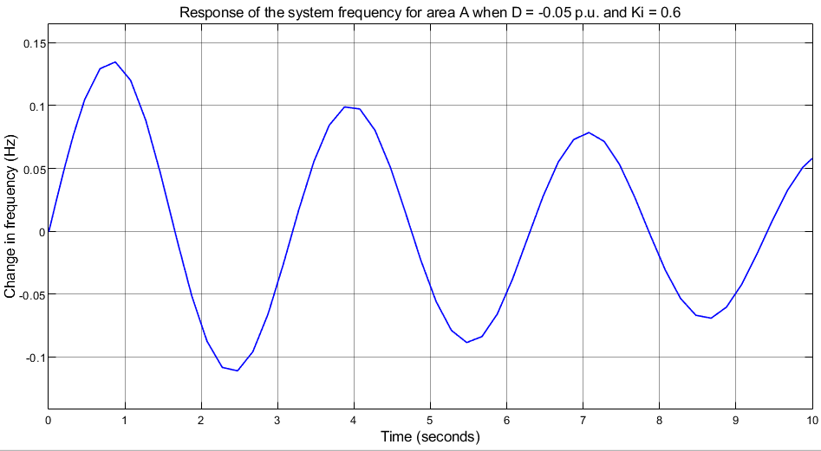
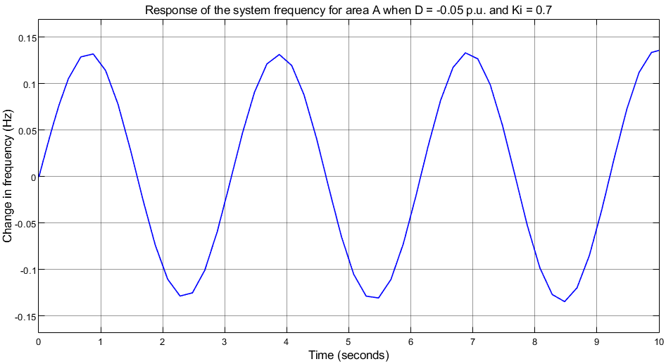
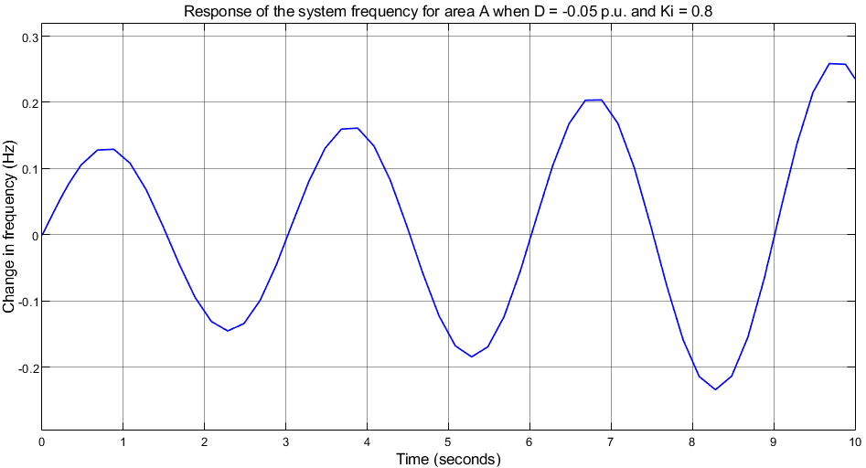
Testing systems Integral gain that causes instability
Ki = 0.3
Ki = 0.5
Ki = 0.6
Ki = 0.7
Ki = 0.8

Slide 6
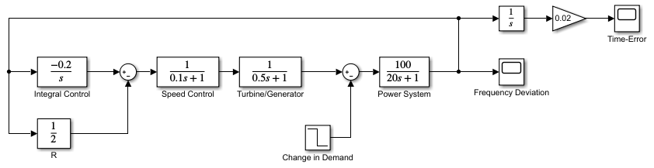
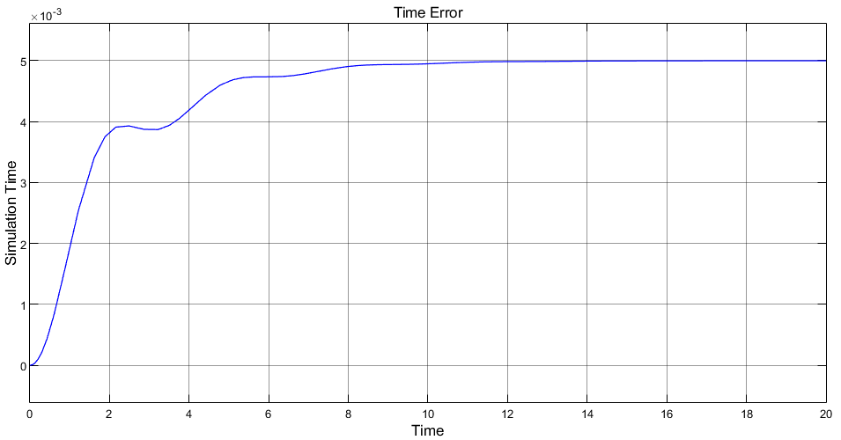



Time error
$$Time \left(clock\right) error =$$
$$t_{e}=\frac{1}{f^{0}} \int_{0}^{T}{∆fdt}$$
$$− \frac{M}{f_{o} x K_{i} }= − \frac{0.05}{50 x 0.2}=5 ms$$

Slide 7
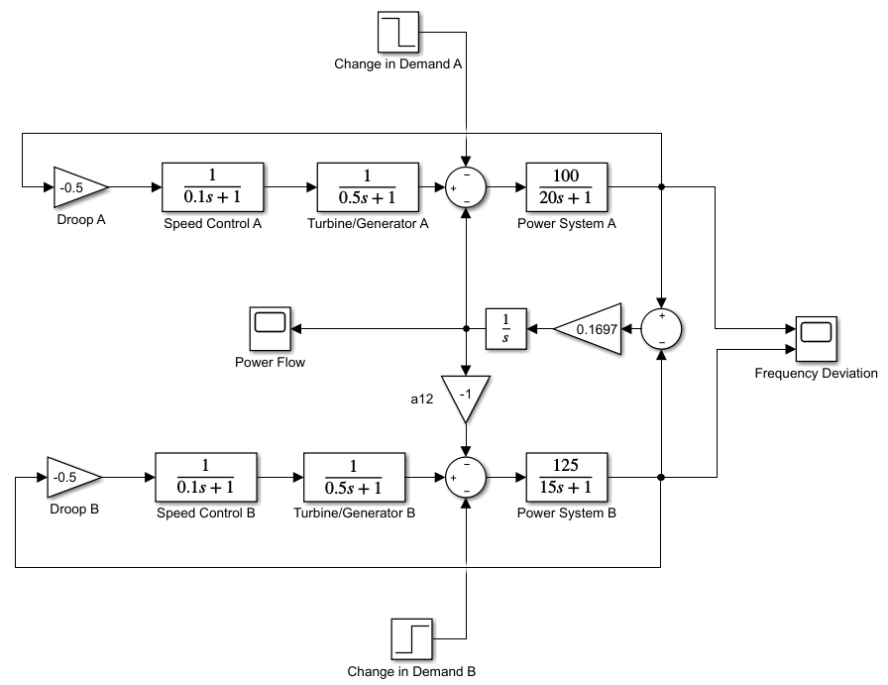
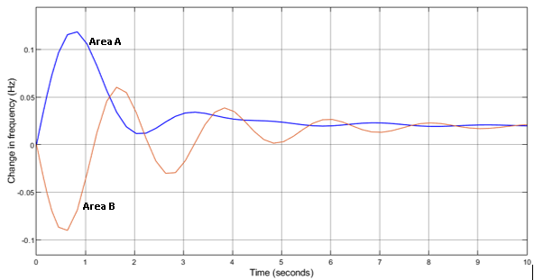
Two-Area system with interconnector

Slide 8
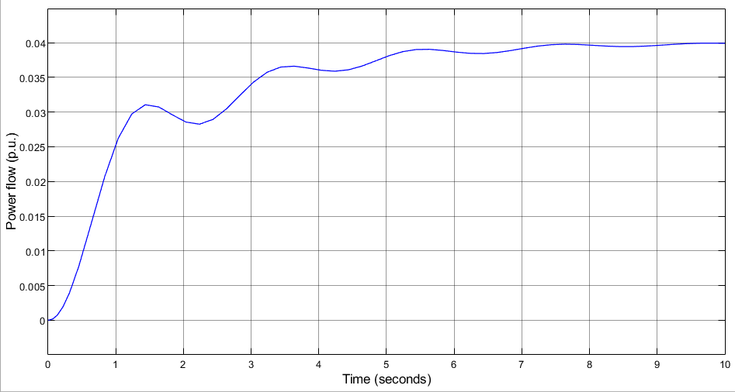
Power flow across the interconnector
Unscheduled power flow between
area A and Area B
Power flow can be returned to 0 using Integral control

Slide 9
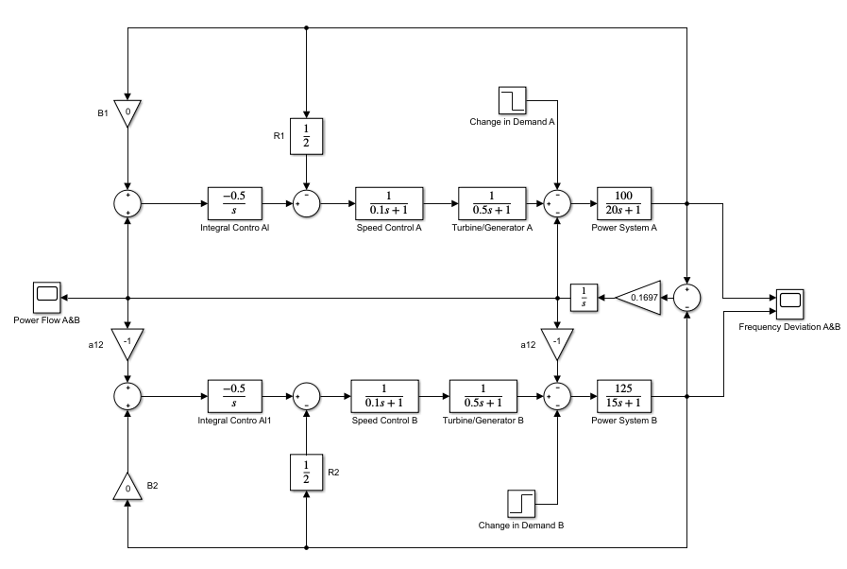
Adding ACE Control to the interconnector system

Slide 10
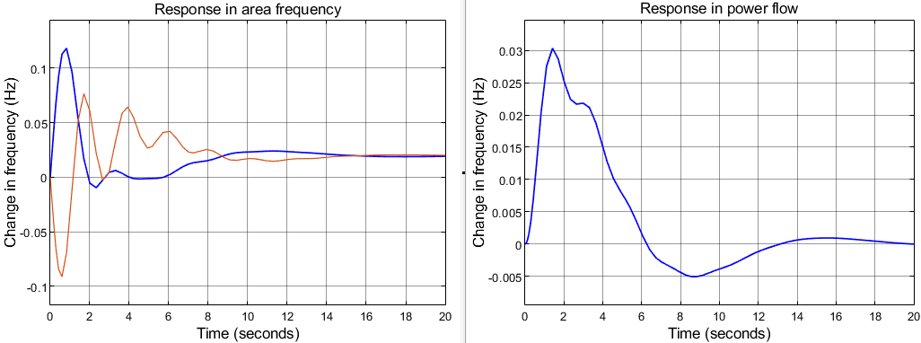
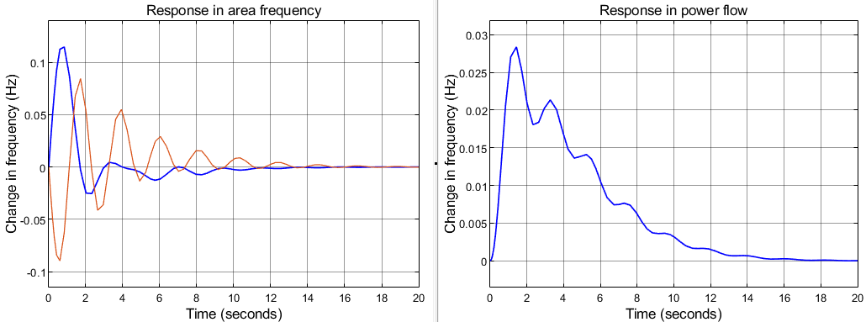
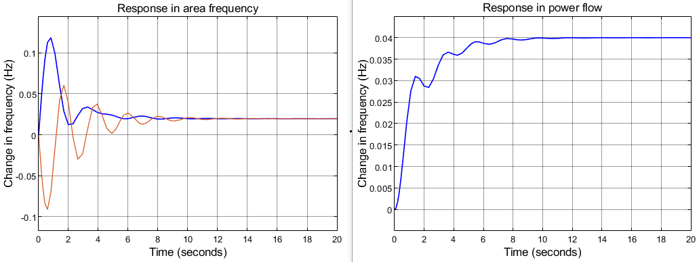



Two-area system with interconnector and ACE Control
Ki = 0.5 & B = 0
Ki = 0.3 & B = 20
Ki = 0.5 B = 0 = p f
Ki = 0 B = 40 = p f
Ki = 0.3 B = 20 = p f
Ki = 0 & B = 40

Slide 11

TIME ERROR IN POWER SYSTEMS

Slide 12
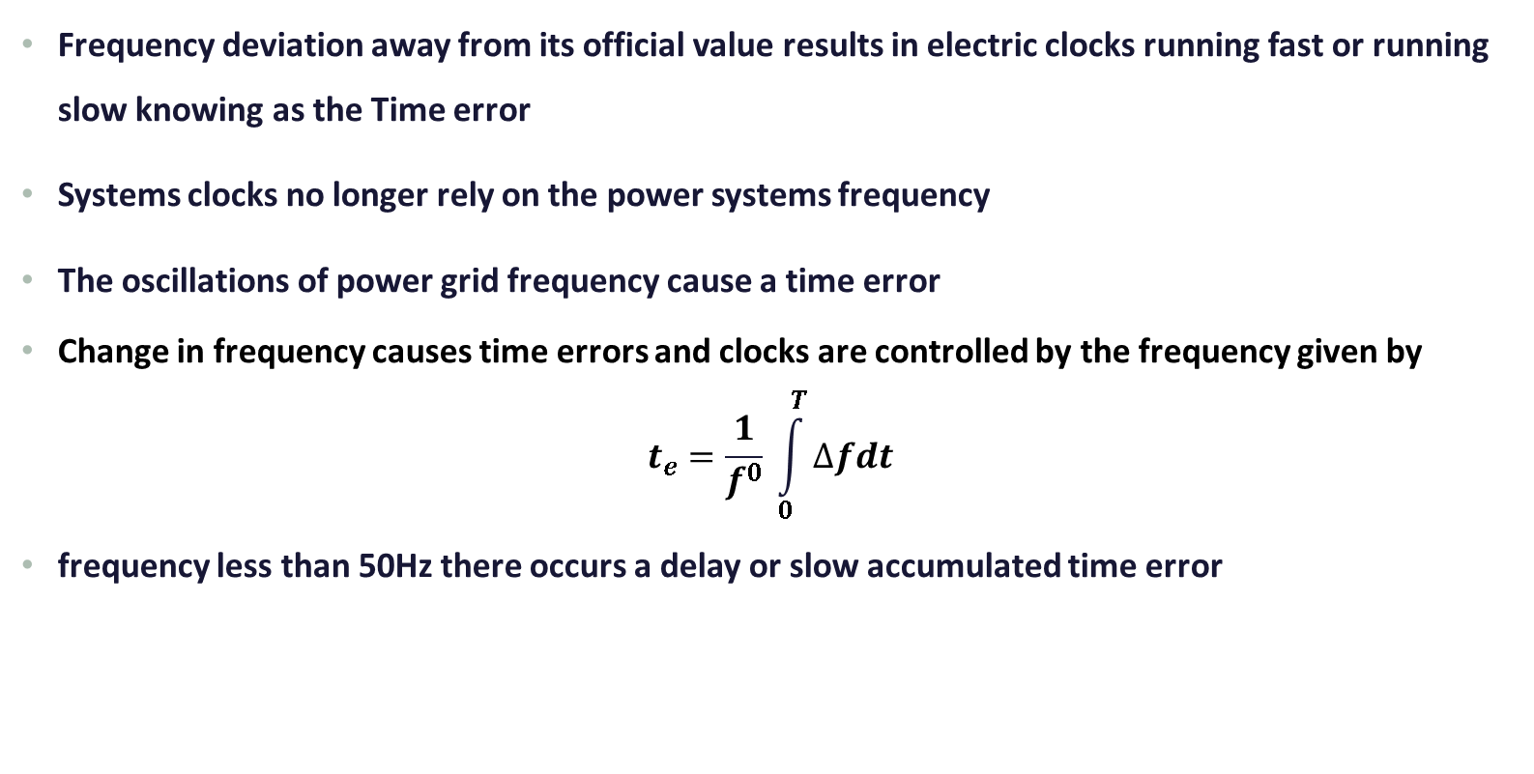
Eliminating Time Error in modern Power system
Frequency deviation away from its official value results in electric clocks running fast or running slow knowing as the Time error
Systems clocks no longer rely on the power systems frequency
The oscillations of power grid frequency cause a time error
Change in frequency causes time errors and clocks are controlled by the frequency given by
$$t_{e}=\frac{1}{f^{0}} \int_{0}^{T}{∆fdt}$$
frequency less than 50Hz there occurs a delay or slow accumulated time error

Slide 13
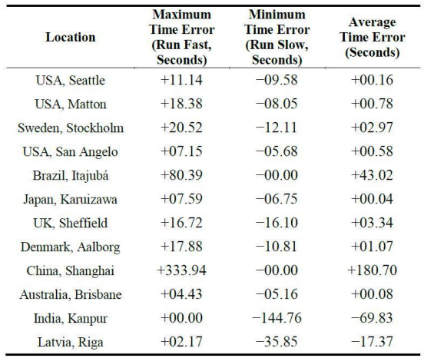
Limits on time error
Time error shall not in normal circumstances exceed ± 10 seconds
EirGrid, in its role as SA monitor
The target frequency resets with SONI and agrees to a time of at least 15 minutes in the future
Synchronous clock is more likely to run fast
Brazil and China with the time error larger than one minute.

Slide 14
Implications of time errors
Time errors in power systems affect the small-signal stability of power systems.
All the systems should operate at the same frequency
Frequency control method is used in interconnected power system during AGC operation
power system has many advantages like Economical operation
If the system frequency bias is set too low, then the adjacent system will respond to the trouble more than its share of bias response.

Slide 15

Any questions

